Slide 1

Dictionary
Lecturer
Rokas Slaboševičius
Data

Slide 2
Today you will learn
Dictionary
What is Dictionary?
Dictionary methods
01
03
When to use Dictionary?
02
Dictionary attributes
03

Slide 3

What is Dictionary?
Dictionary
A dictionary is a data structure in the C# programming language that allows key-value pairs to be stored.
This means that each entry in the dictionary consists of a unique key and its associated value.
A key can be any type of value, usually in the form of text or a number, and a value can be any type of object.
The dictionary is dynamic and makes it easy to add, remove or modify entries.
The dictionary uses unique keys (key), which must have a value equivalent.

Slide 4
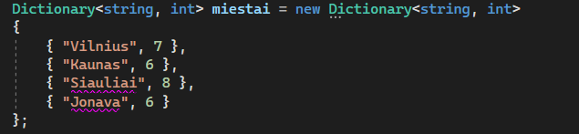
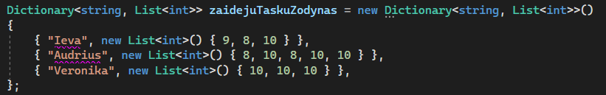
When to use Dictionary?
Dictionary
The dictionary is useful when we want to perform an efficient key search.
It allows you to quickly retrieve the value using the key as an index.
In addition, the dictionary keys and values can be used to perform various operations such as searching, sorting, filtering or displaying all entries.
A dictionary is very useful when we have large amounts of data that we want to organise and manage efficiently.

Slide 5
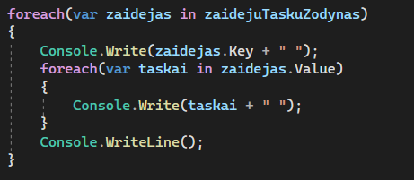
Dictionary attributes
Dictionary
Fast access times: Dictionaries allow quick access to values using a key as an index. This is particularly important when we have large amounts of data and want to search or retrieve values efficiently.
Simple and efficient data organisation: dictionaries allow data to be stored in key-value pairs, making it easier to organise and manage information. They have a dynamic structure that makes it easy to add, remove or modify entries.
Multi-operational: Dictionaries can be manipulated in a variety of ways, such as searching, sorting, filtering or displaying dictionaries. This gives more flexibility and functionality in applications that need to manipulate data.
Unique key requirements: dictionaries ensure that keys are unique, meaning that no two records in a data structure can have the same key value. This helps to avoid conflicts and ensures that each entry in the dictionary is unique.

Slide 6

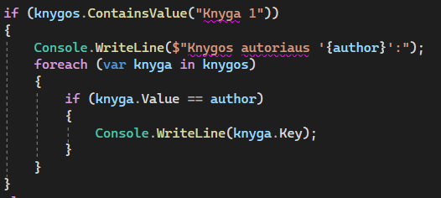
Dictionary methods
Dictionary
As a dictionary consists of complex key-meaning combinations, there are a number of important and inherent techniques.
The main methods you may often need to use when choosing a dictionary as your collection type are:
Dictionary.ContainsKey(x): Checks if the value you entered in the key exists.
Dictionary.Remove(x): removes an entry with key x
Dictionary.ContainsValue(x): checks if there is a value that contains the value x
Also, since a dictionary consists of keys and values, we can call them separately using the words Dictionary.Keys and Dictionary.Values, which have their own structure equivalents KeyCollection and ValueCollection

Slide 7

Dictionary
Task 1
DEVELOP METHODS FOR THE FOLLOWING TASKS
Create a dictionary to store the names and ages of three people. Print out the names and ages of all the people in the dictionary.
Create a dictionary to store the names of countries and their capitals. Ask the user to enter the name of the country and show its capital (the method must return the capital).
Create a dictionary to store the names and quantities of fruit. Design a method to print the existing fruits. Create a method that allows the user to add or update fruits/quantities (If a fruit already exists its value should be updated).

Slide 8
Dictionary
Task 2
DEVELOP METHODS FOR THE FOLLOWING TASKS
Create a dictionary to store the names of cities and their populations. Ask the user to enter the name of the city and show its population.
Create a dictionary to store words and their translations. Allow the user to enter a word and display its translation.
Create a dictionary to store students' names and grades. Ask the user to enter the student's name and display their grades.
Create a dictionary to store the names of the months and their day numbers. Print out the names of months with fewer than 31 days.

Slide 9
Dictionary
Task 3
DEVELOP METHODS FOR THE FOLLOWING TASKS
Create an application that allows the user to enter a list of words. The program must count the number of times each word appears in the list and print the results. Use a dictionary to complete this task.
Create a dictionary to store film titles and genres. Write a function that accepts a genre name and returns a list of films belonging to that genre. Allow the user to select the genre and print the list of films.
Create a program that generates a random sequence of numbers. Allow the user to enter the desired length and range of the sequence. The program must generate the sequence of numbers and store it in a dictionary, where the key is a number and the value is the number of occurrences of the number. Print the generated sequence and the number of repetitions.

Slide 10
Dictionary
Task 4
Create a method that returns whether a coin flip resulted in heads or tails. Enhance your program so that it asks the user to enter their first and last name when starting. The user should see the following menu options: 1. Flip a coin 2. Print current results 3. Log out.
When option 1 is chosen, the program flips a coin and updates the count of how many times the user has flipped heads. When option 2 is selected, the program should display the percentage of times the user has flipped heads or tails.
Upon selecting option 3, the program asks to enter a first and last name. If a new name is entered, a new record should be created in a dictionary to track the results for the new person.
If "Admin Admin" is entered during the login process, the program should only display two menu options for the user: 1. Print current results 2. Log out.
When option 1 is selected, it should print the percentage statistics of all users' coin flips.

Slide 11
Dictionary
https://learn.microsoft.com/en-us/dotnet/api/system.collections.generic.dictionary-2?view=net-7.0
Useful information

